Slide 1
current technology usage
File created on: 29/7/2024 12:30:02 am HKT

Slide 2
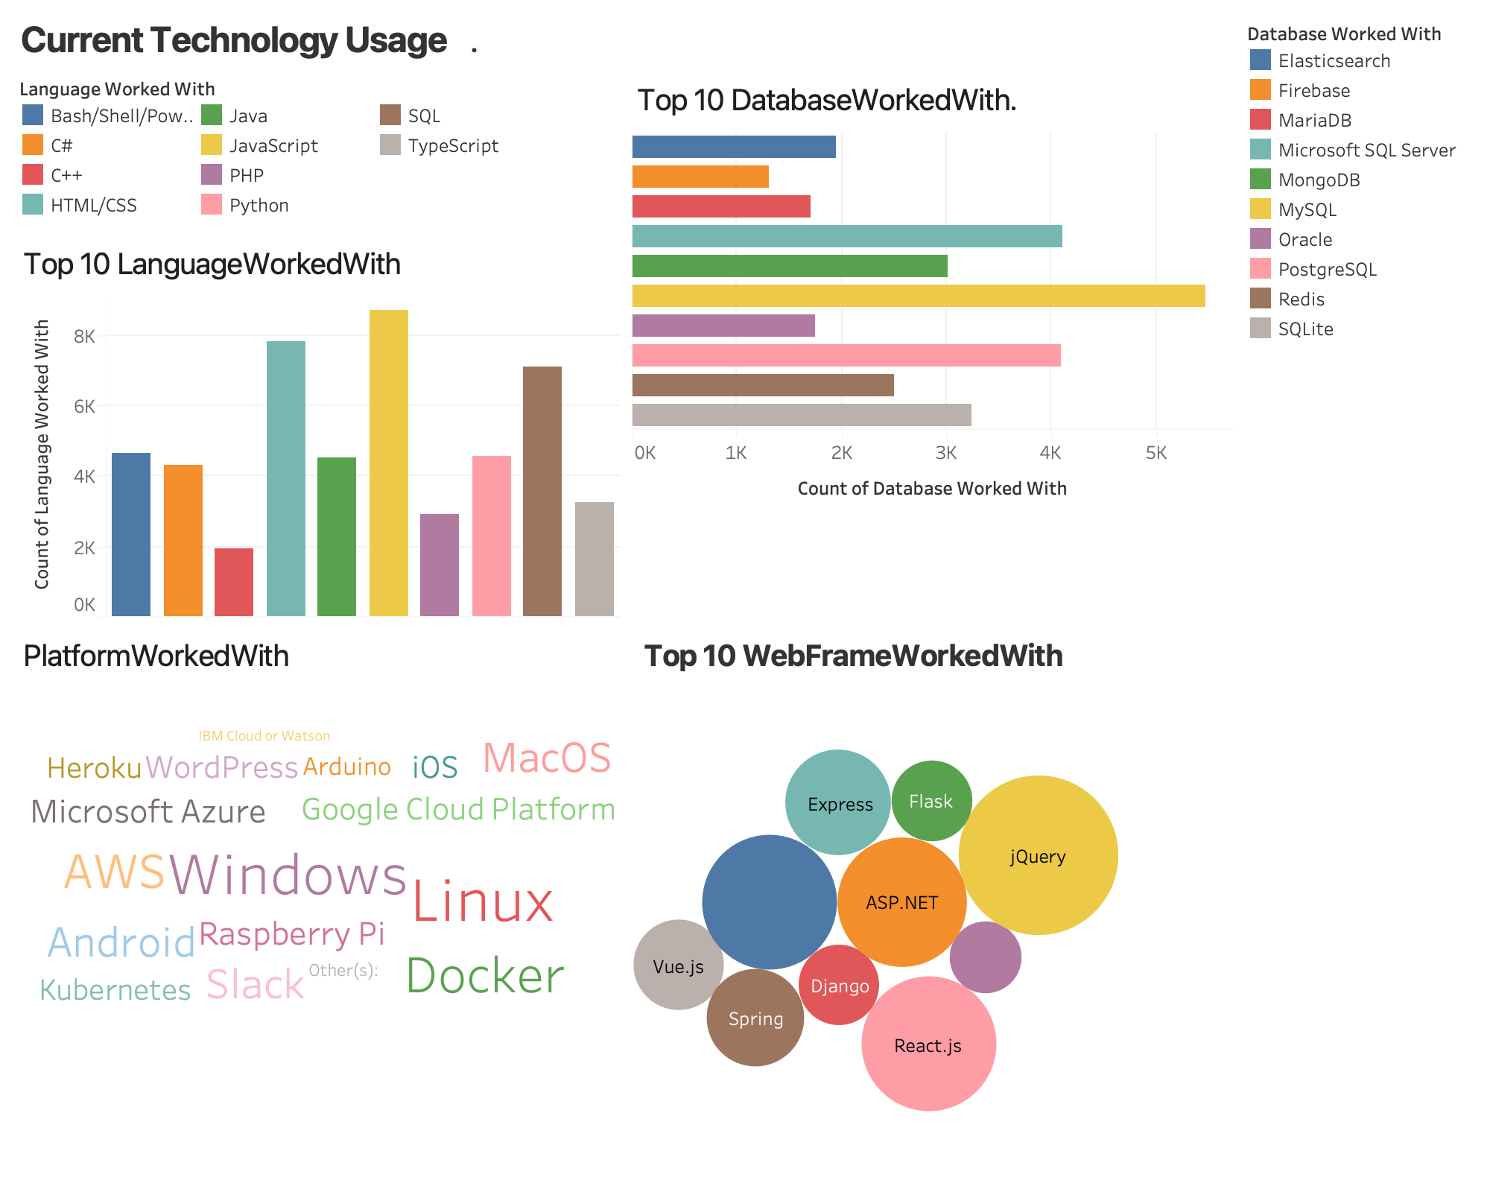

Slide 3
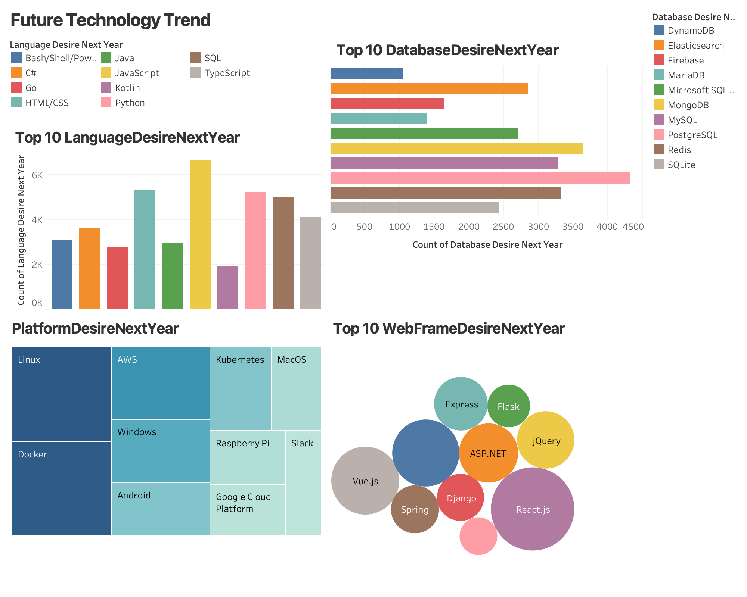

Slide 4
